Slide 1

Step On Up:
Peripheral Arterial Disease (PAD)
2023

Slide 2

Acknowledgements
Thank you to Janssen Pharmaceuticals, Inc. for support of this program.

Slide 3
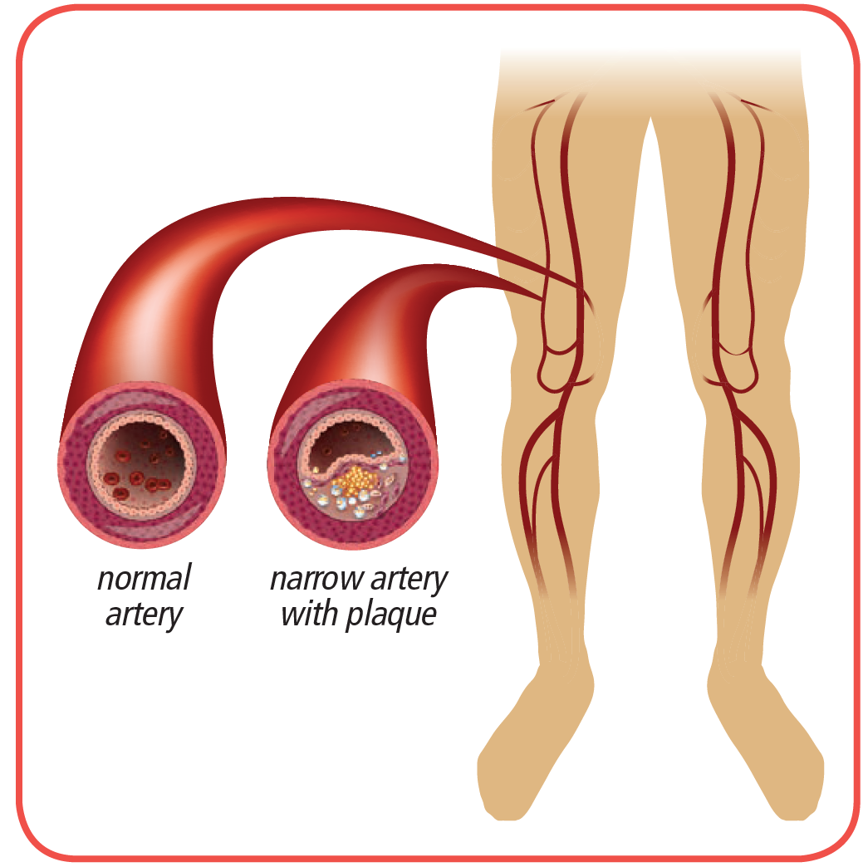
What is Peripheral Arterial Disease?
Peripheral arterial disease, or PAD, is a health condition caused by reduced or sluggish blood flow in the arteries of your legs or arms.
Arteries are tubes or vessels under the skin and muscles that carry oxygen to your body.

Slide 4
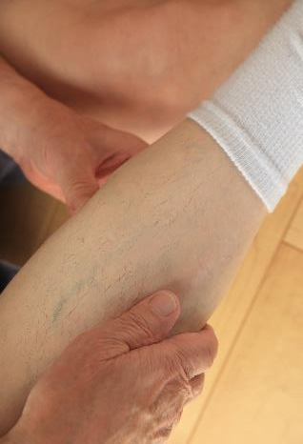
What does PAD feel like?
You might have PAD and not know it. The symptoms can be similar to normal signs of aging.
Cramps, pain or tired feeling in your leg or hip muscles when you walk, climb stairs or exercise.
Pain might go away when you rest.

Slide 5

What are other signs of PAD?
A sore on your foot or leg that won’t heal or is slow to heal
A leg or foot that looks reddish-blue when you are sitting
For men, they may experience erectile dysfunction, especially those with diabetes

Slide 6
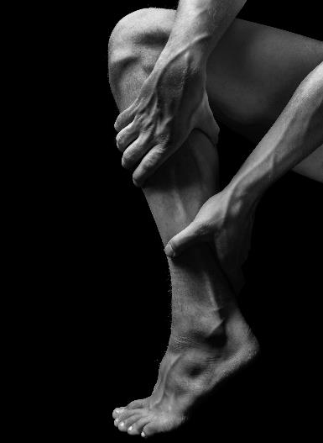
What are other signs of PAD?
Leg or foot feels cool to the touch
Dry and scaly skin on the leg
Poor toenail growth
Hair loss on feet or toes

Slide 7
Why is it important to know about PAD?
PAD is associated with higher risk of heart attack or stroke.
PAD can get worse over time.
Complete blockage of blood flow can cause permanent damage to the area below the blockage on your body.
If not treated, PAD can cause infection,(gangrene) or lead to amputation.

Slide 8
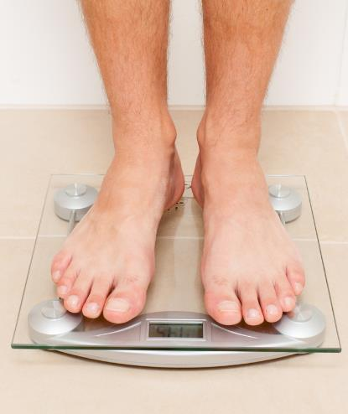
Who is at risk for having PAD?
High blood sugar, diabetes
Smoking - current or past
High blood pressure
High cholesterol
Age over 70
Overweight or obese
Physically inactive
Notes:
High blood pressure is sometimes called the ‘silent killer’ because there are no symptoms.
Smokers are four times more likely to develop PAD than people that don’t smoke.
High cholesterol contributes to the build-up of fatty deposits in your arteries.
People with a BMI of 25 or over have a higher risk of a heart attack or stroke.

Slide 9
What are the tests for PAD?
Tell your nurse or doctor if you any symptoms or tell them if you have any risk factors even if you do not have symptoms
They can quickly evaluate you using an
Ankle-Brachial Index, also known as an ABI
  Compares blood pressure in feet and arms
  Painless
  Inexpensive

Slide 10

What do my ABI results mean?
  ABI = Highest BP in Foot
  Highest BP in Arm
  Normal ABI – 1.0 – 1.4
  ABI less than 0.9 – More testing may be needed. See your health care provider.

Slide 11

What are the tests for PAD?
Doppler Ultrasound
  Handheld device pressed against the skin of your leg or foot
  Uses soundwaves and
sends pictures of your arteries to a screen to show how well your blood is flowing

Slide 12
What are the tests for PAD?
Treadmill Test
  You walk on a treadmill at different speeds to show how exercise affects your leg pain and how severe your symptoms are

Slide 13

What are the tests for PAD?
Magnetic Resonance Angiogram (MRA)
  You lie flat inside a large, tunnel-like tube.
  Pictures are taken to show where your arteries are, and how much they are blocked.

Slide 14

What are the tests for PAD?
Arteriogram
  A special medicine called contrast is given to you through an IV.
  You lie flat and a machine with a camera takes pictures using X-rays to find the exact location of a blockage in your arteries.

Slide 15
What are the treatments for PAD?
Regular walking and activity
  At home, or supervised exercise sometimes called Cardiac Rehab
Medications
Surgery and other procedures
Notes:
The goal of a walking program is to help you walk longer distances without as much pain.
Be sure to take your medicines for cholesterol, high blood pressure, and diabetes.
You may be prescribed medicines to prevent blood clots or relax the arteries to help with blood flow.
Some patients may need treatments to open up a narrowed artery or even bypass a blocked artery.

Slide 16
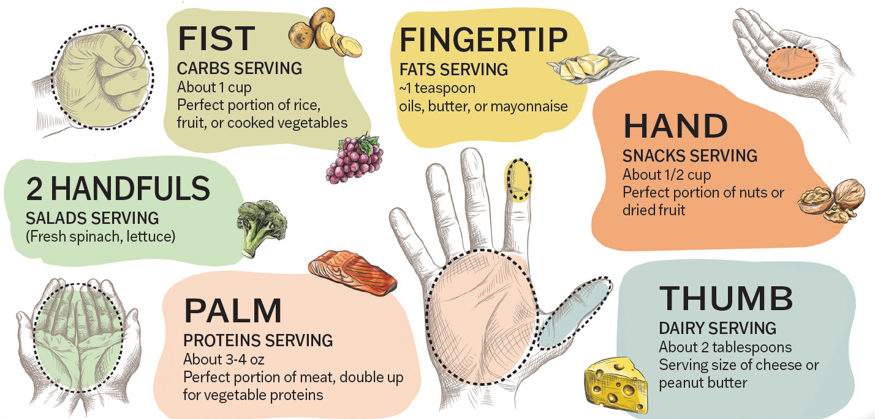
What are the treatments for PAD?
If you smoke, stop – smoking cessation resources are available
Join a Cardiac Rehabilitation exercise program
Follow a heart-
healthy eating plan
Lose weight
Notes:
You can ask your nurse or doctor for tips to help you quit smoking.
Cardiac rehab programs are covered by medicare and other insurances for treating PAD.
Following a DASH or Mediterranean eating plan will lower your risk of heart attack or stroke.

Slide 17
Where can I get information on PAD?
Preventive Cardiovascular Nurses Association
  PCNA.net/PAD
American Heart Association
  heart.org/en/health-topics/peripheral-artery-disease
NHLBI
  nhlbi.nih.gov/health/peripheral-artery-disease
Vascular Nurses
  vascularcures.org/patients/patient-resources

Slide 18

Questions

